Slide 1
TIME & WORK

Slide 2
Efficiency Technique
Work done by a person in unit time is defined as efficiency in Time and Work
Problems
A can complete a work in 10 days so efficiency of A per day = 100/10 = 10%

Slide 3
Example : If a person can complete his work in 5 days. What will be his efficiency?
We have: 100/5 = 20%. Therefore, the person’s efficiency is 20%.
Summarizing this, we can say that if a person can do his job in n days, his efficiency will be given as below:
Efficiency =(100/n) %.
1.A is 30% more efficient than B. How much time will B alone take to complete a job which A alone could have done in 20 days?
A.13 B .26 C.17 D.46

Slide 4
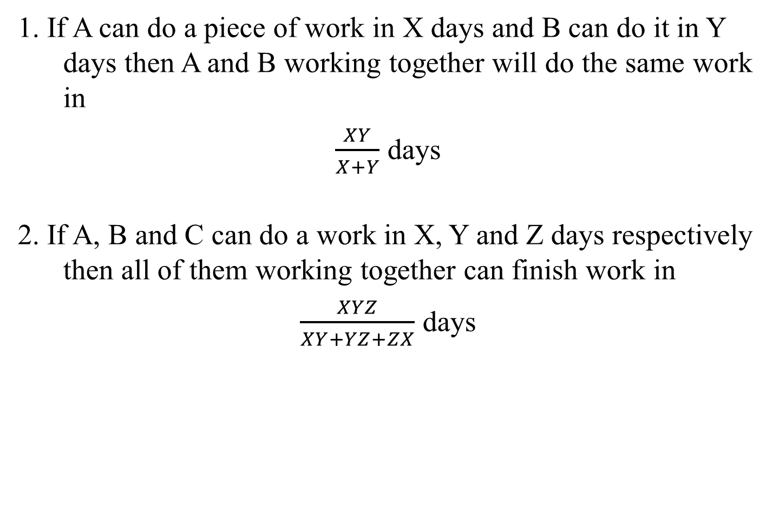
FEW CONCEPTS
1. If A can do a piece of work in X days and B can do it in Y days then A and B working together will do the same work in
$\frac{XY}{X+Y}$ days
2. If A, B and C can do a work in X, Y and Z days respectively then all of them working together can finish work in
$\frac{XYZ}{XY+YZ+ZX}$days

Slide 5
LCM Method to Solve Problems
Here we take the LCM of time taken by the members to do the complete work
That LCM will behave as a value of total work
Total Work = LCM
Total Work = No of days * work done in 1 day (per unit time)
Thus, No of days = LCM/Efficiency
where efficiency = work done in per unit time

Slide 6
Example : A completes a work in 10 days where as B completes the same work in 12 days. In how many days they will complete the work by working together?

Slide 7
Solution:
LCM of 10 & 12 = 60
Thus total work = 60
Efficiency of A = 60/10 = 6
Efficiency of B = 60/12 = 5
Efficiency of A and B together = 11
Thus Time taken by A and B together is = 60/11 days

Slide 8
Example : If Arti and Rita can do a job in 8 hours (working together at their respective constant rates) and Art can do the job alone in 12 hours. In how many hours can Rita do the job alone?

Slide 9
Sol: Arti + Rita = 8
Arti = 12
LCM = 24
Let’s consider 24 units as total work.
Work done by Arti in one day = 2 units
Work done by Arti and Rita together in one day = 3 units
Thus, work done by Rita alone in one day = (3 – 2) 1 unit
No. of days taken by Rita to complete the job alone = 24/1 = 24.

Slide 10
PRACTICE QUESTIONS
1. A completes the work in 10 days and B completes the work in 15 days In how many days they will complete the work.
A. 6 B. 7 C. 5 D. 8
Notes:
1. Work done by A in 1 day = 1/10
Work Done by B in 1 day = 1/15
Work done By A & B together in 1 day = 1/10 + 1/15 = (3+2)/30 = 5/30 = 1/6
As A & B Completes 1/6 work in one day So they will complete the whole work in 6 Days.

Slide 11
2.A can finish a work in 18 days and B can do the same work in 15 days. B worked for 10 days and left the job. In how many days, A alone can finish the remaining work?
A. 5 B. 7 C. 6 D. 8
Notes:
2. LCM of 18 and 15 = 90
Efficiency of A and B is 5 and 6 respectively
10 days work of B = 6*10 = 60
Remaining work = 30
No of days taken by A to complete remaining work = 30/5 = 6 days

Slide 12
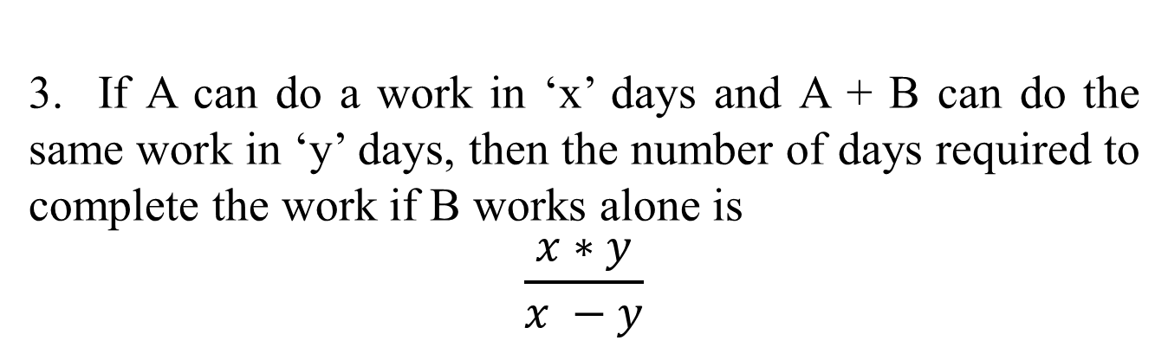
3. If A can do a work in ‘x’ days and A + B can do the same work in ‘y’ days, then the number of days required to complete the work if B works alone is
$$\frac{x∗y}{x −y}$$

Slide 13
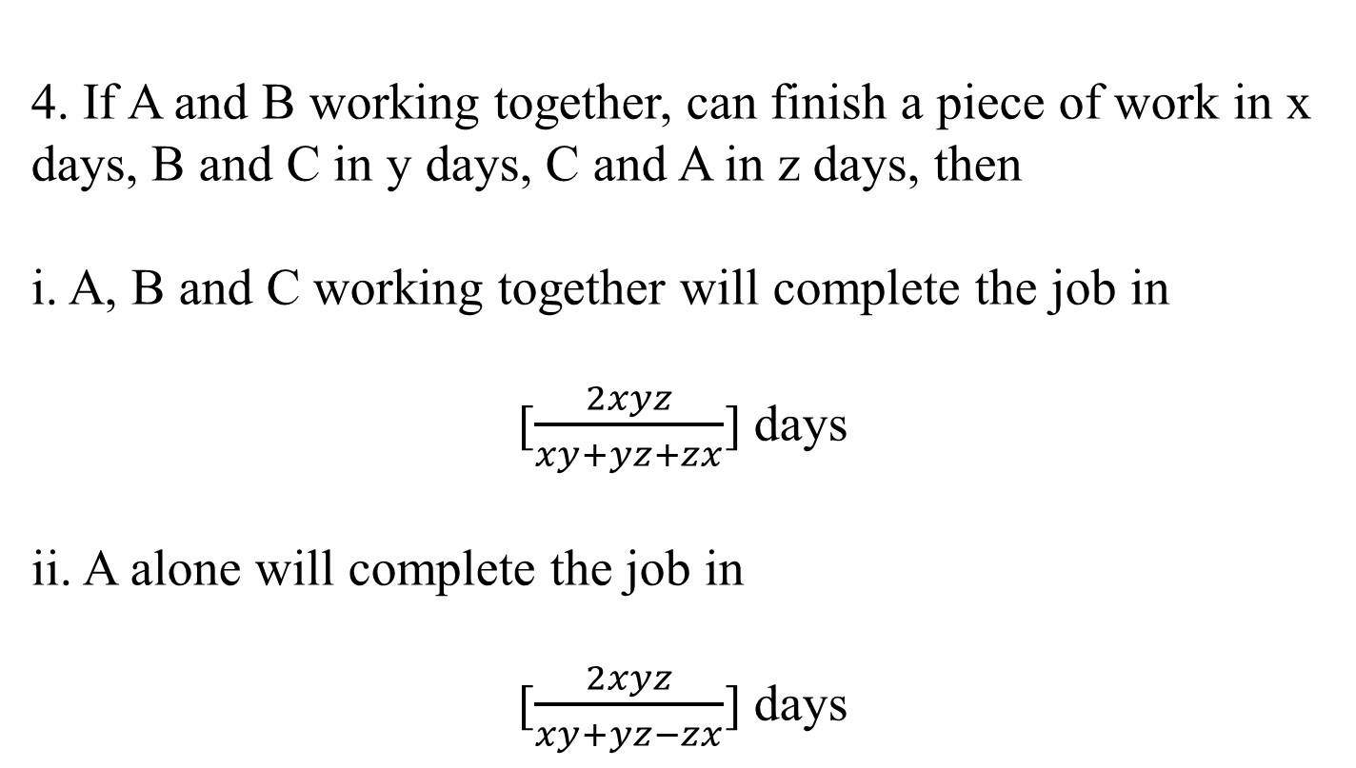
4. If A and B working together, can finish a piece of work in x days, B and C in y days, C and A in z days, then
i. A, B and C working together will complete the job in
[$\frac{2xyz}{xy+yz+zx}$] days
ii. A alone will complete the job in
[$\frac{2xyz}{xy+yz−zx}$] days

Slide 14
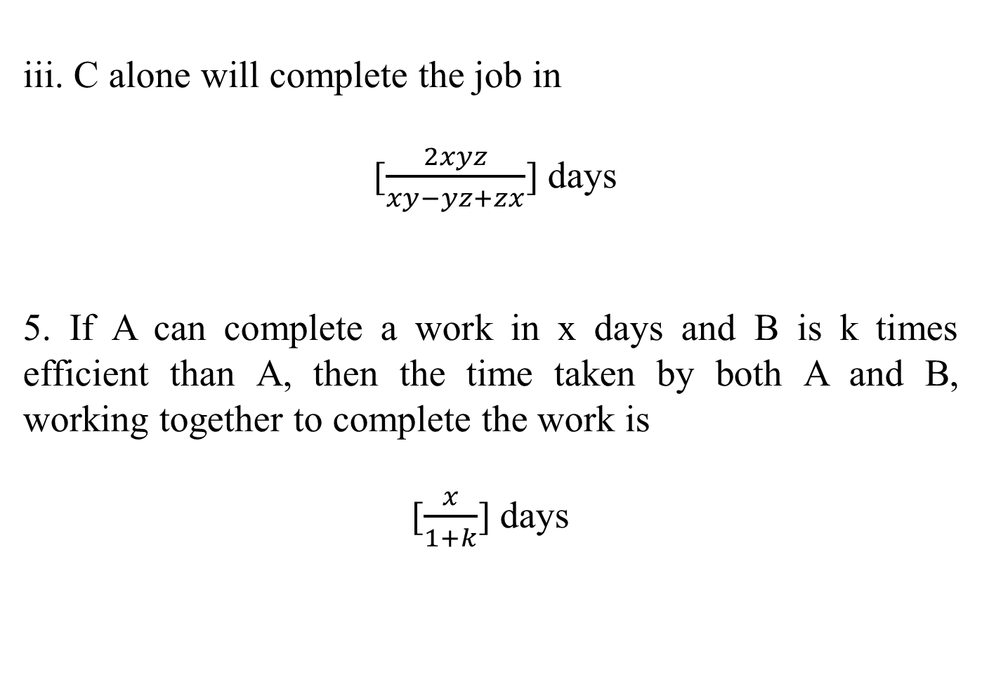
iii. C alone will complete the job in
[$\frac{2xyz}{xy−yz+zx}$] days
5. If A can complete a work in x days and B is k times efficient than A, then the time taken by both A and B, working together to complete the work is
[$\frac{x}{1+k}$] days

Slide 15
EXAMPLE :
Sakshi can do a piece of work in 20 days. Tanya is25%more efficient than Sakshi. The number of days taken by Tanya to do the same piece of work is:
A.15 B.16 C.25 D.27

Slide 16
Explanation:
Ratio of times Sakshi and Tanya = 125 : 100 = 5 : 4.
Suppose Tanya takes x days to do the work.
5 : 4 :: 20 : x
x = 4 x 20/5
x = 16 days.
Hence, Tanya takes 16 days to complete the work.

Slide 17
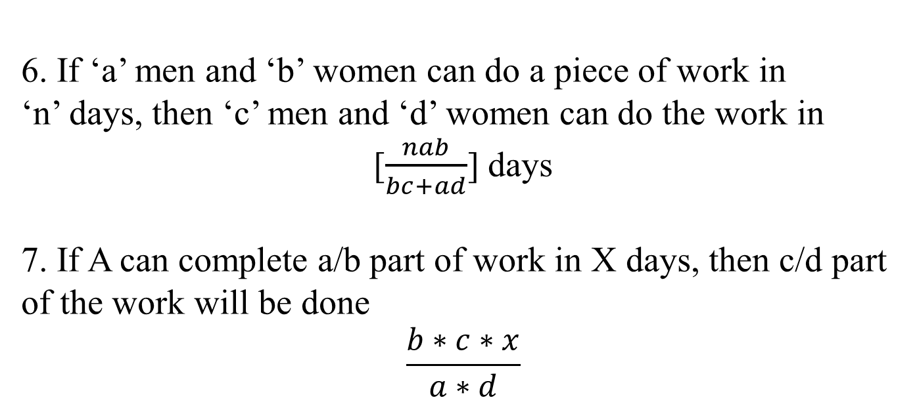
6. If ‘a’ men and ‘b’ women can do a piece of work in ‘n’ days, then ‘c’ men and ‘d’ women can do the work in
[$\frac{nab}{bc+ad}$] days
7. If A can complete a/b part of work in X days, then c/d part of the work will be done
$$\frac{b∗c∗x}{a∗d}$$

Slide 18
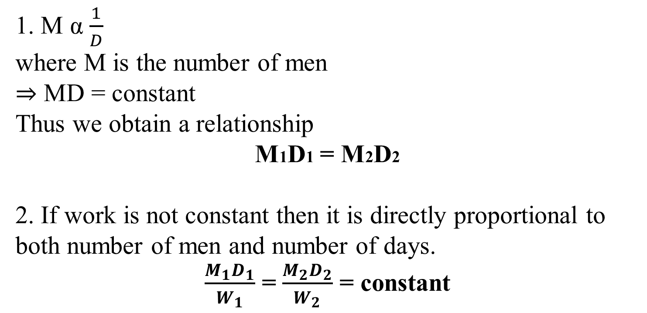
CONCEPT : Men v/s Days
1. M α$\frac{1}{D}$
where M is the number of men
⇒ MD = constant
Thus we obtain a relationship
M1D1 = M2D2
2. If work is not constant then it is directly proportional to both number of men and number of days.
$\frac{M_{1}D_{1}}{W_{1}}$ = $\frac{M_{2}D_{2}}{W_{2}}$ = constant

Slide 19
Example: 45 people take 18 days to dig a pond. If the pond would have to be dug in 15 days, then the number of people to be employed will be:
A case of inverse proportion in which more people would take less day
Number of people required = (45 x 18)/15 = 54 people

Slide 20
Example: 76 ladies complete a job in 33 days. Due to some reason some ladies did not join the work and therefore it was completed in 44 days. The number of ladies who did not report for the work is ______.

Slide 21
Solution: M1*D1*T1/W1 = M2*D2*T2/W2
Work requires 76 x 33 = 2508 man days
If N ladies did not report for work
Then (76 – N) x 44 = 2508
76 - N = 2508/44 = 57
N = 76 – 57 = 19

Slide 22
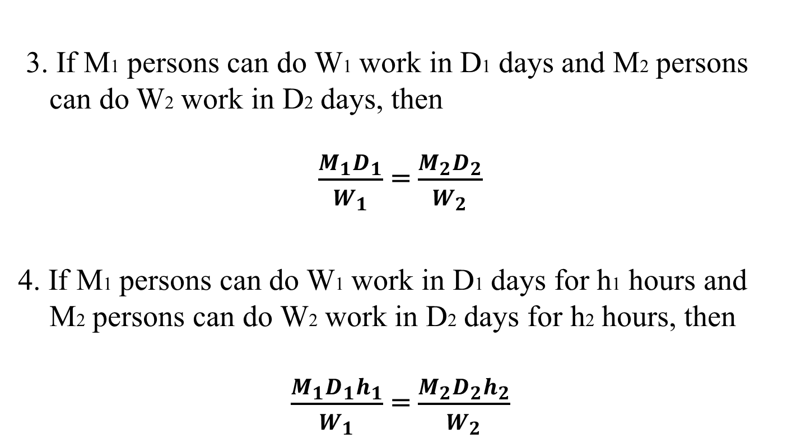
3. If M1 persons can do W1 work in D1 days and M2 persons can do W2 work in D2 days, then
$\frac{M_{1}D_{1}}{W_{1}}$ = $\frac{M_{2}D_{2}}{W_{2}}$
4. If M1 persons can do W1 work in D1 days for h1 hours and M2 persons can do W2 work in D2 days for h2 hours, then
$\frac{M_{1}D_{1}h_{1}}{W_{1}}$ = $\frac{M_{2}D_{2}h_{2}}{W_{2}}$

Slide 23
PRACTICE QUESTIONS
1.Three persons Ram, Shyam and Kamal can do a job in 10 days, 12 days and 15 days respectively. In how many days can they finish the job working together?
5 B 4 C. 6 D. 7
2. Tannu and Rekha can do a job in 12 days. Rekha alone can finish it in 36 days. In how many days can Tannu and alone finish the work?
15 B. 16 C. 18 D. 19
Notes:
1.
LCM of 10, 12 and 15 = 60
Eff of Ram shyam and kamal = 6,5 and 4 resp
Eff together = 15
Time = 60/15 = 4
2. LCM = 36
Eff of T+R = 3
Eff of R = 1
So T = 2
Time = 36/2 = 18

Slide 24
3. Deepak and Anil can do a piece of work in 10 days and 30 days respectively. They work together and Deepak leaves 5 day’s before the work is finished. Anil finishes the remaining work alone. In how many days is the total work finished?
A.11.35 days B.11.25 days C.11.30 days D.11 days
4. Shambhu is twice as good as workman as Bablu and together they finish a piece of work in 18 days. Find the total number of days in which Bablu can finish the work.
A. 27 days B. 54 days
C. 56 days D. 68 days
Notes:
3. Assume the time for completion = T
Since Deepak leaves 5 days before the work is finished. So, no. of days worked by Deepak = T – 5 and Anil works, so, number of days worked by Anil = T
Deepak’s work + Anil’s work – 1
(T-5/10)+T/30=1
T=11.25
If shambhu does 2 unit work then Bablu does 1 only
In 18 days they do = 54 unit
Time taken by bablu = 54/1 = 54 days

Slide 25
5. Ritu can complete a piece of work in 5 days, but with the help of her son she can do it in 3 days. Find the time taken by the son alone to complete the work.
A. 7.5 days B. 13 days C. 11 days D. 9 days
6. 4 men and 6 women working together can complete the work within 8 days. 3 men and 7 women working together will complete the same work within 10 days. In how many days 10 women will complete this work?
60 B.40 C.70 D.10
Notes:
5. where we have one person work and together work done. Then we can easily get the other person work just by subtracting them. As, Son's one day work = (1/3 −1/5 )=(5−3/15 )=2/15
So son will do whole work in 2/15 days = 7.5 days which is =7.5 days

Slide 26
7. 24 men working 8 hours a day can finish a work in 10 days. Find the number of men required to finish the same work in 6 days working 5 hours a day?
A. 60 B. 64
C. 80 D. 72
8. A work could be completed in 100 days by some workers. However, due to the absence of 10 workers, it was completed in 110 days. The original number of workers was:
A. 100 B. 110
C.55 D. 50
E. None of these
Notes:
6. 4M+6W×8D =32+48
3M+7W×10D =30+70
32M-30M=2M
70W-48W=22
2M=22W 1M=11W
(4M×11W)+6 =50×8/10
400/10 =40DAYS.
ANSWER IS 40 DAYS.
7. 24*8*10 = 6*5*x
X = 64

Slide 27
9. A can do a work in 12 days. When he had worked for 3 days, B joined him. If they complete the work in 3 more days, in how many days can B alone finish the work?
A. 6 days B. 12 days C.4 days
D. 8 days E. None of these
10. A is thrice as good a workman as B, therefore, A is able to finish a piece of work in 60 days less that B. The time (in days) in which they can do it working together is:
A. 22 B. 22 ½ C. 23
23 1/4 E. None of these
Notes:
11. A completes the work in 12 days. Work done by A in 3 days = 3 units
Remaining work is 9 units
And this is done by A and B in 3days
Which means 3 unit in a day where B works 2 unit
Therefore Time for B = 12/2 = 6 days
10. A’s eff = 3 and B’s = 1
Ration of time taken by A and B = 1:3
2 units = 60
1 unit = 30
Time taken together = 90/4 = 22.5

Slide 28
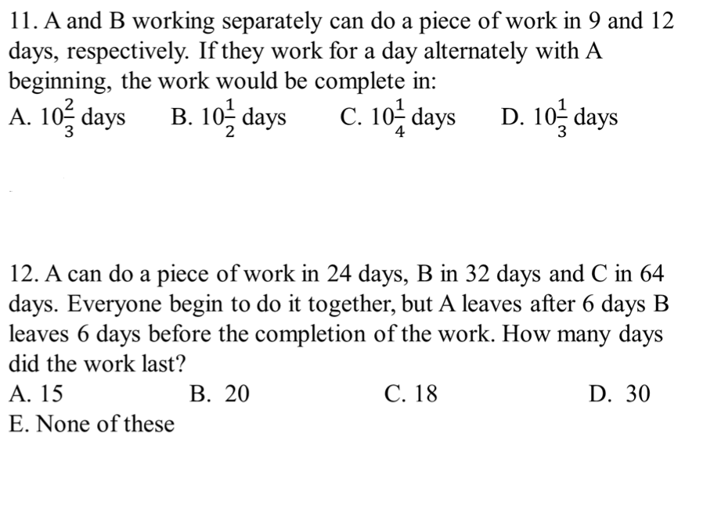
Notes:
11. Portion of the work done by A and B in first two days=1/9+1/12=7/36
Portion of work done in the first 10 days=35/36
Remaining work=1-35/36=1/36
Therefore, time taken by
A =1/36*9=1/4 day
Hence, total time=10+1/4=10(1/4) days.
12. A = 24 days B = 32 days C = 64 days. Fraction of work done in one day by A = 1/24 by B = 1/32 by C = 1/64. During the six days before A leaves,the fraction of the work that has been done is 6/24 = 1/4 by A 6/32 = 3/16 by B 6/64 = 3/32 by C. Total fraction of work done in First 6 days = 1/4 + 3/16 + 3/32 =(8 + 6 + 3)/32 = 17/32. Fraction of work left = 1 -17/32 = 15/32.
Since B leaves 6 days before the completion of the work,it means that C works alone for 6 days. The fraction of work C does alone in those 6 days is 6/64 = 3/32. Therefore fraction of work done before B's departure = 15/32 - 3/32 = 12/32 =3/8. Let X be the number of days in which B and C did 3/8 of the work. Therefore, x/32 is done by B and x/64 is done by C. This shows that x/32 + x/64 = 3/8 Multiply through by 64 2x + x = 3 * 8 3x = 24 x = 24/3 = 8 days. Total number of days = 6 + 8 + 6 = 20 days.

Slide 29
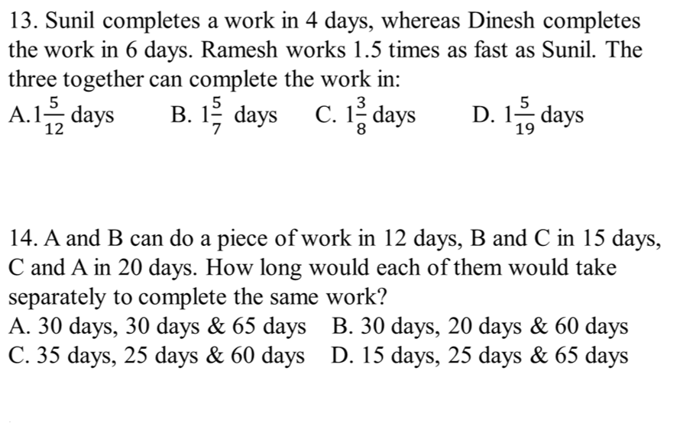
Notes:
13. Time taken by ramesh =4*2/3=8/3 days
Work done by all the three in 1 day
¼+1/6+3/8=19/24
Required time=24/19=1(5/19) days.
14. A+B = 12 B+C = 15 A+C = 20
Lcm of (12,15,20) = 60 Efficiency is A+B = 5 B+C = 4 A+C = 3
Total efficiency 2 (A+B+C) = 12 A+B+C = 6
Individual efficiency A = 6 - 4 = 2 B = 6 - 3 = 3 C = 6 - 5 = 1
Individual time taken A = 60/2 = 30 days B =60/3 = 20 days C = 60/1 = 60 days

Slide 30
15. Harbans Lal can do a piece of work in 24 days. If Bansi Lal works twice as fast as Harbans Lal, then how long would they take to complete the work working together?
8 days B. 12 days C. 6 days D. 4 days
16. A complete 3/4 of a work in 12 days. In how many days he would complete 1/8 of the work?
3 B. 2 C. 1 D.4
Notes:
15.Here x=24, k=2
Together time taken be=(x/1+k)days
8 days
16. Here a=3, b=4, x=12, c=1 and d=8
Therefore, number of days required to complete 1/8 of the work
=b*c*x/a*d=4*1*12/3*8=2 days.

Slide 31
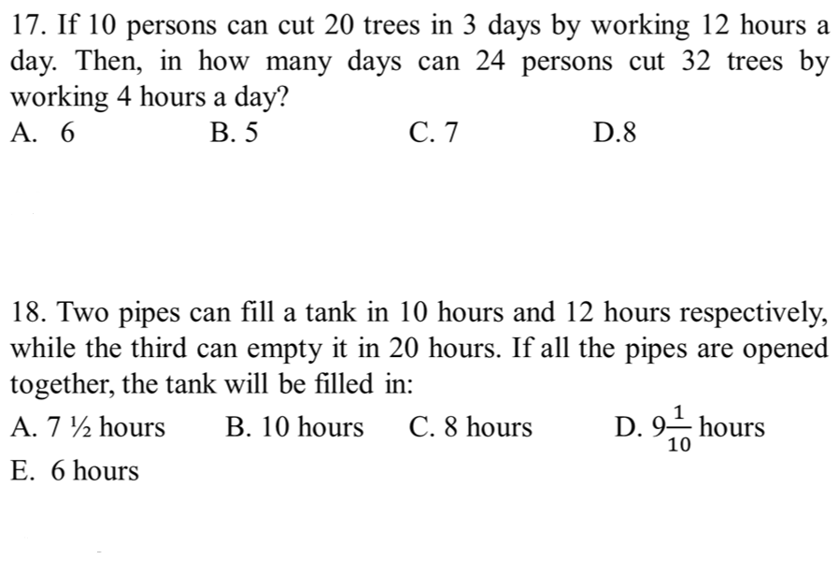
Notes:
19.M1D1T1W2=M2D2T2W1
10*3*12*32=24*D2*4*20
D2=6 days
20. LCM = 60
Efficiency of A and B = 6 and 5
And eff of C = -3
Time = 60/8 = 7.5

Slide 32


